Slide 1
Image Classification using Semi-Supervised Learning
Deep Learning Final Project
Kuixian Zhu (kz1041@nyu.edu)
Marvin Mananghaya (msm796@nyu.edu)
Daniel Rivera Ruiz (drr342@nyu.edu)
Deep Learning - Spring 2019
New York University

Slide 2
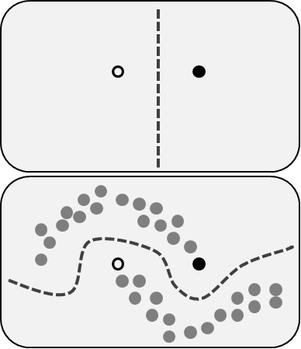
Problem Definition
Image classification: 512k unlabeled images + 128k labeled images (64k train + 64k val), 1000 classes
Approach: use SSL techniques to take advantage of the larger set of unlabeled images
Algorithms explored:
SSL-DCGANs
Deep Clustering
Mean Teacher

Slide 3
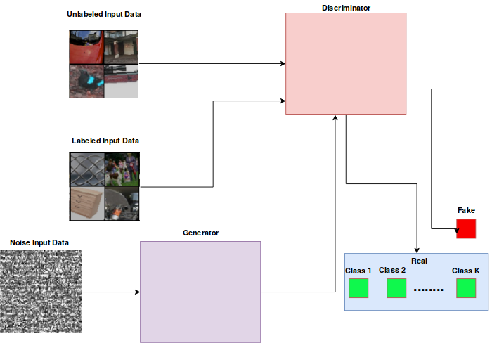
SSL-DCGANs
In the style of Guillermo, 2019:
“So DCGANs do well in learning features unsupervised? What if we do it semi-supervised?“
- Radford et al., 2015
“You could totally do that, just change the classification problem from real vs fake to real k classes and fake”
-Salimans et al., 2016
But what happened? Tl;dr It didn’t work out so well.
GANs are sensitive to hyperparameter changes
Easy to fall to non-convergence
One network can overpower another
Maybe there are simpler yet better ways to perform semi-supervised learning?

Slide 4
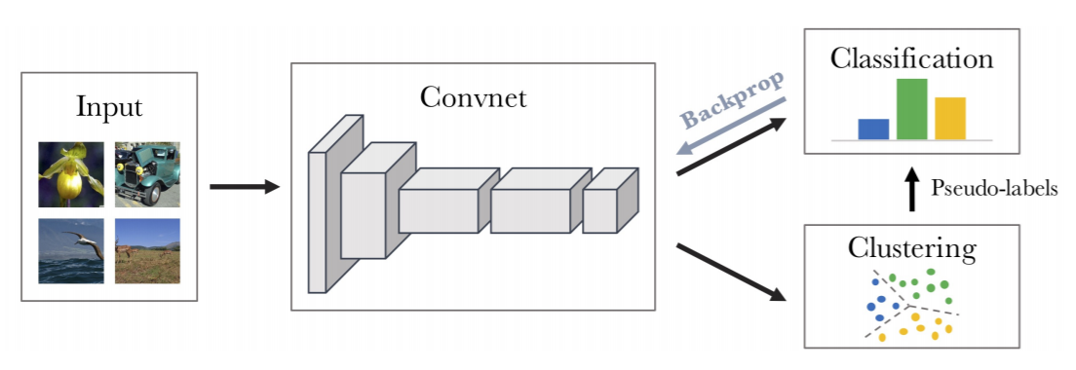
Deep Clustering
Basic idea: alternate between clustering of the image descriptors and updating the weights of a convnet by predicting the cluster assignments.

Slide 5
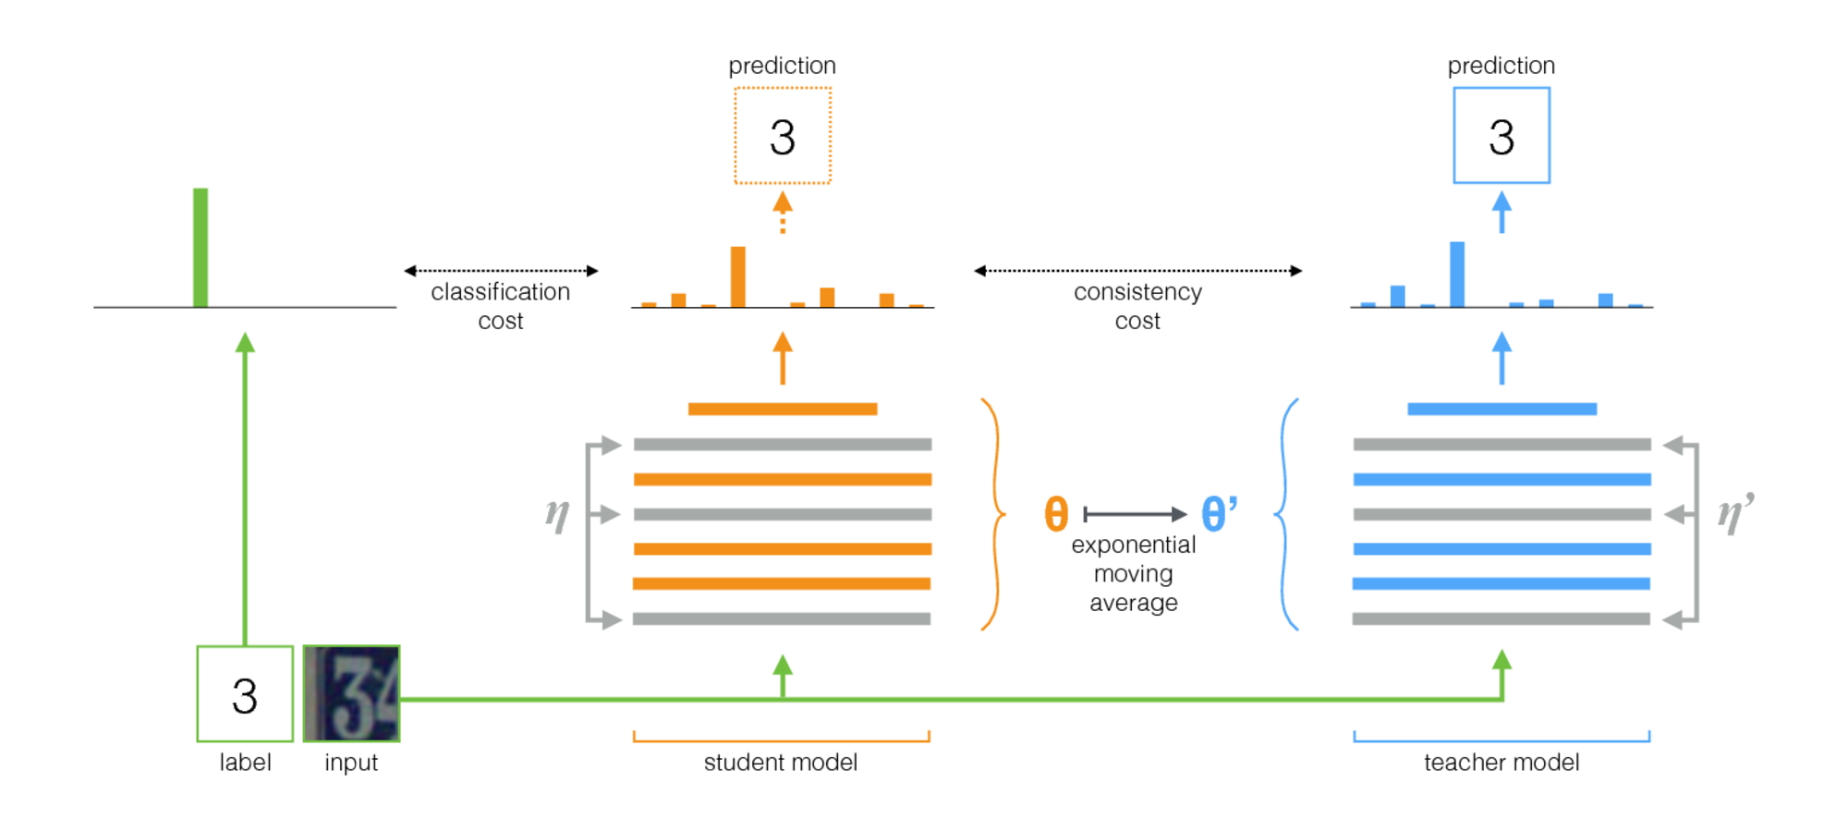
Mean Teacher
Mean Teacher is a simple, yet scalable framework for semi-supervised learning.
1. Take any supervised model, call it the student.
2. Make a copy of the student model, call it the teacher. Let the teacher's weights to be the exponential moving average (EMA) of the student's weights.
3. While training, use the same images as inputs to both models, but add random noise (augmentation) to them separately.
4. Update the student by the classification loss as usual, yet add an additional consistency loss between the student and teacher outputs.

Slide 6
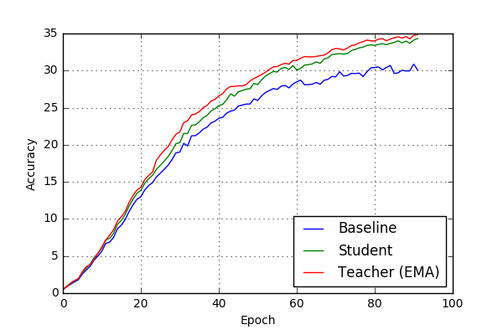
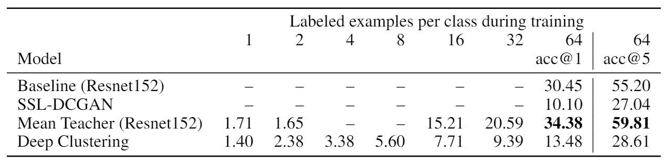
Results and Analysis
Mean Teacher training curves
Model comparison (validation accuracy)

Slide 7
Conclusions
SSL can be very powerful because it fully exploits unlabeled data, which is easier and cheaper to collect.
In general, deep learning models rely greatly in the amount of data available and SSL models are no exception to this rule.
Due to time and computing resources limitations, we were not able to push any of our models to the limit.

